Slide 1
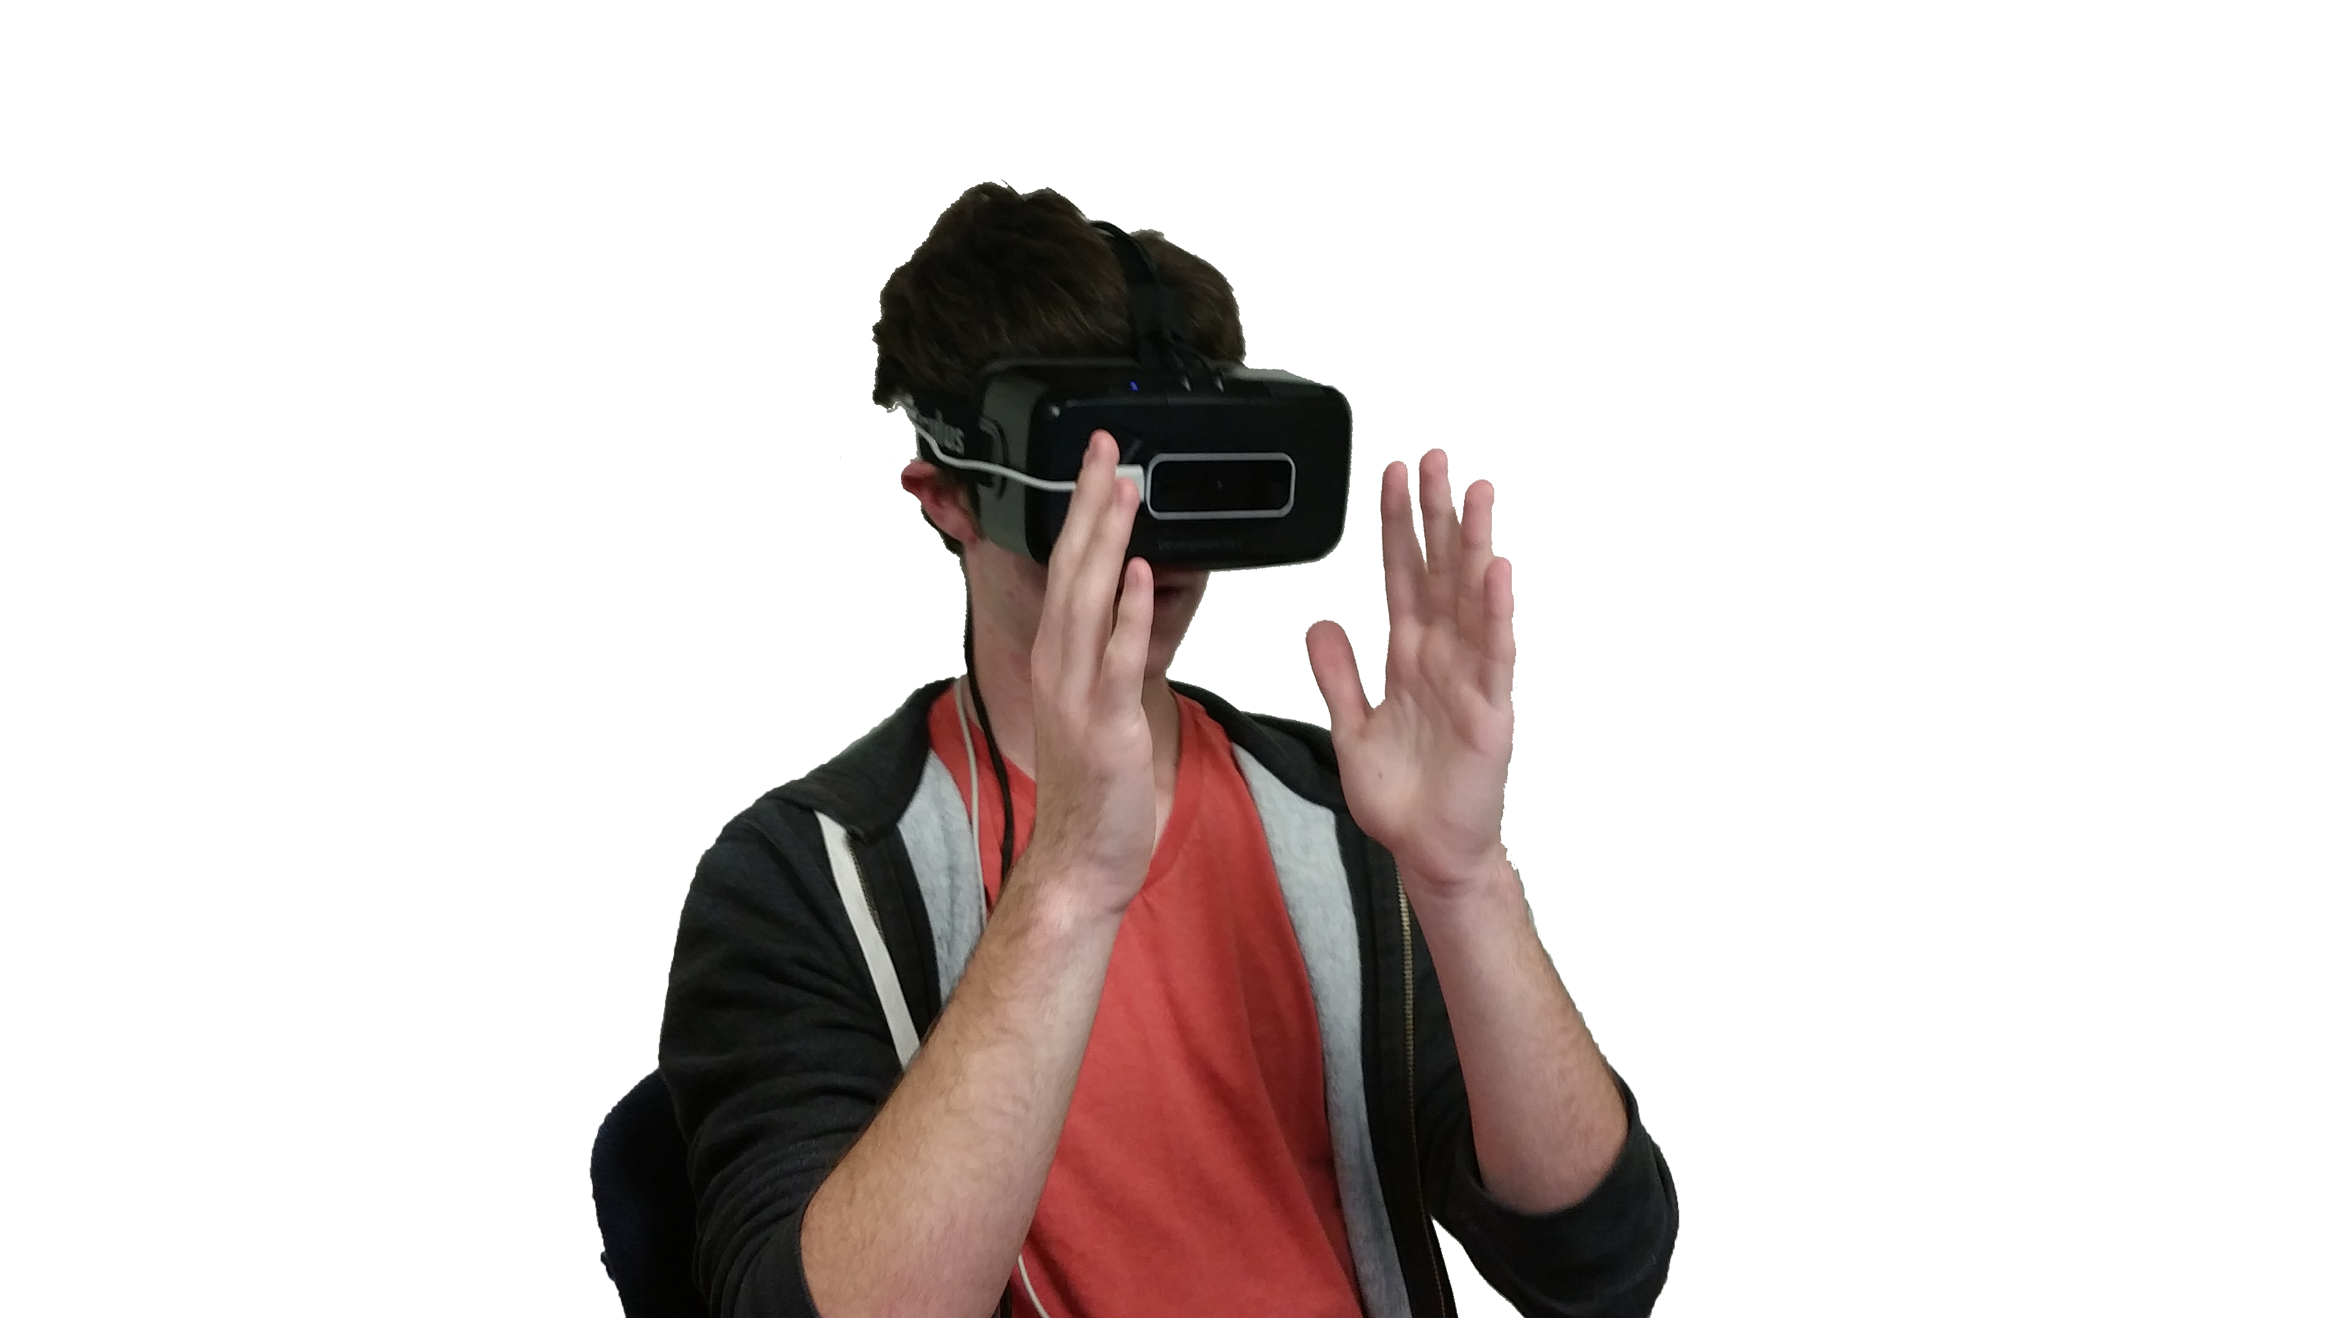
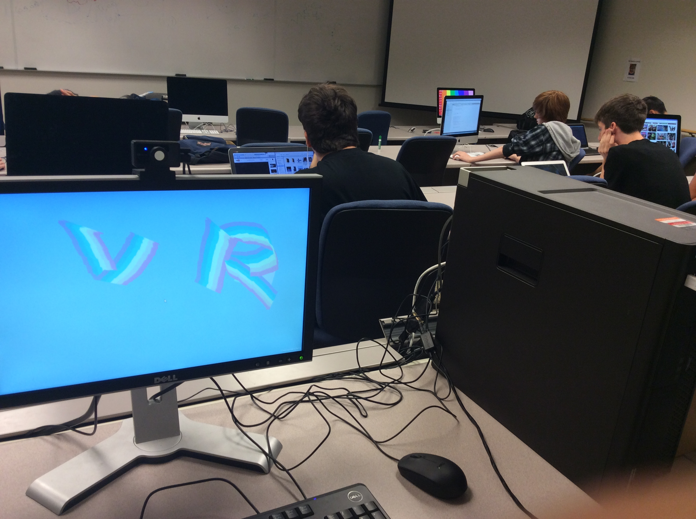
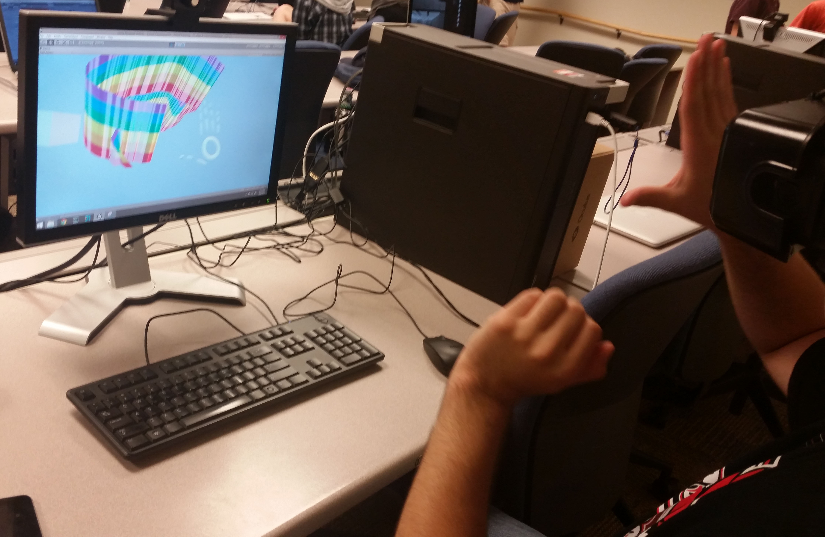
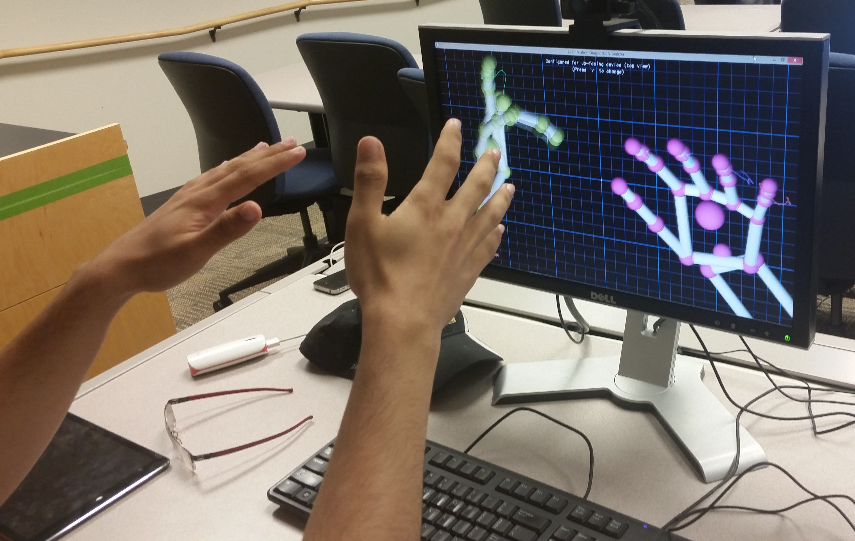
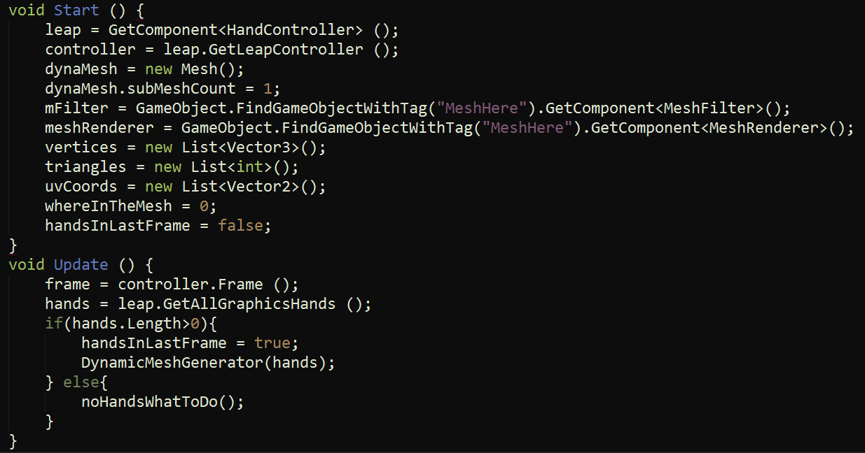
Virtual Painting: Painting in the Virtual Realm
Joseph Wold, Zorawar Singh
Bret Jackson, Nate Osher
Using the Unity Engine, the Oculus Rift, and Leap Motion Technology, we created an Immersive Virtual Reality Experience so that you can draw in 3D.
Leap Motion
Oculus Rift
A sensor device that supports hand and finger motions as input, so that you can reach into the world beyond the screen – in virtual reality.
There is a lack of development in 3D user interfaces for painting in Virtual Reality. Our research tackles this problem, and provides a possible solution to bridge interactions in real world to the virtual world.
This program was made using the programming language C# (C Sharp) in the Unity engine, with Oculus Rift and Leap Motion. We use the position of the user’s thumb and index finger to make the software generate a trail of meshes that follows the user’s hand. Atop this core functionality, we added conditions to make the user’s experience more intuitive, and to allow for more control.
By tracking the user’s thumb and index finger, the software generates a trail, or “mesh” along the path the hand covers. The user has the ability to change the size of the mesh generated by altering the distance between the aforementioned fingers. Further, incorporating the use of both hands, the user is given greater control over when the meshes are generated; the presence of both hands indicates the draw mode, and the first detected hand (to accommodate right and left hand dominants) acts as the drawing brush.
The Oculus Rift is a set of virtual-reality goggles that uses state-of-the art displays and stereoscopic visuals to provide a truly immersive Virtual Experience.
Virtual Painting shows the practicality and potential of the research - from a technology and art perspective. In slightly over two
Potentially the next steps for the research are the following:
- Making more versatile tools - 3D Modeling
- Adding more intuitive controls - Rigging
- The ability to modify existing meshes - Lighting Control
- Material Control - Greater Precision
weeks, we have demonstrated the ability to “draw”, and control how we draw - as one would expect with a pencil.

